Slide 1



CATS, MICE and Small Pelagic Species in the California Current Ecosystem
André E. Punt
School of Aquatic and Fishery Sciences
University of Washington, Seattle, WA 98195

Slide 2
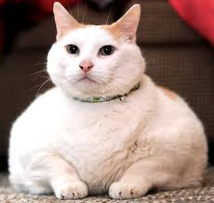
On Ecosystem Models and Fisheries
Single-species models remain the standard for providing management advice worldwide, but some problems related to ecosystem effects require models that have multiple species and climate-related impacts.
However, many ecosystem models (Complex Assessment Tools, CATS) are very complicated, which means that it is impossible to (a) estimate the values for their parameters by fitting them to data, and (b) quantify uncertainty using standard methods and examine sensitivity to alternative assumptions.

Slide 3

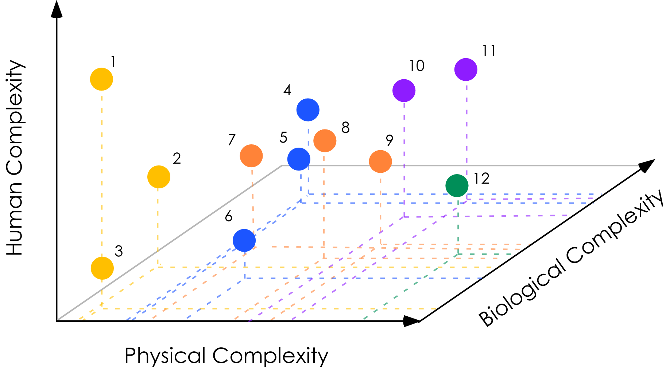

CATS (Complex Assess Tools)
MICE
Models of Intermediate Complexity for Ecosystem assessments
RATS (Relegate All Top Species)
Ref: Plaganyi et al 2011 Mar. Freshw. Res.

Slide 4

MICE in a nutshell
1. Ability to address tactical questions
2. Intermediate complexity
3. Focus on subset of the ecosystem
4. Address specific management questions
5. Are fit to data
6. Account for major uncertainties
7. Can include linked physical and human dimensions
8. Based on extensive expert/stakeholder consultation
Plaganyi et al. (2014): Fish and Fisheries
Plagányi, É., et al. (2012) Models of intermediate complexity for ecosystem assessment to support
tactical management decisions in fisheries and conservation. Fish Fisheries

Slide 5
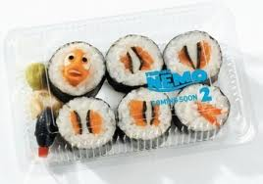
MICE Examples
South Africa:
  Punt & Butterworth hake-seal MRM
  Abalone, urchins, lobsters and fish predators
Antarctic / CCAMLR:
  Krill, seals, penguins, fish, whales
  Baleen whales – krill
Australia:
  Coral Sea pelagic system (tuna, sharks, squid, myctophids)
  Gulf of Carpentaria – banana &tiger prawns , key predators; climate impacts
  Crown of Thorns starfish and predators on the Great Barrier Reef
  Crocodiles and sawfish in Northern Territory
Italy:
  Hake, lobster, prey (Bee!)

Slide 6
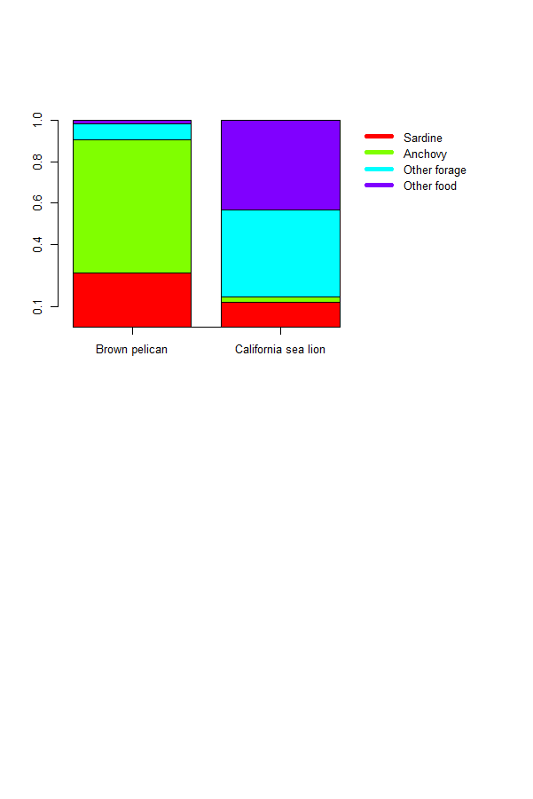
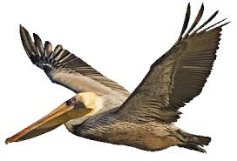
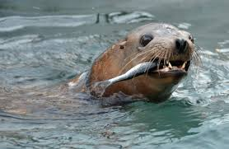
Pacific Sardine and the California Current System
Pacific sardine is fished in Mexico, Canada and the US.
The diets of several predators include substantial proportions of sardine and anchovy in the diets.
We will focus on brown pelican and California sea lion.

Slide 7
Background
Expectations for a [Useful] Ecosystem Model
It must cover the entire range of the northern subpopulation of Pacific sardine (Baja California to northern Vancouver Island).
The fisheries in Mexico, California, the Pacific Northwest and Canada must be explicitly represented.
The model hindcasts must be validated. For example, they should replicate the behavior of major ecosystem components (especially sardine) during 1930-present.
The dynamics of sardine should be modeled to a level consistent with the level of complexity for evaluating a harvest control rule in a single-species context.
Management of other groups in the ecosystem should be based on the control rules actually in place (rather than assuming constant catch or constant fishing mortality).

Slide 8
Objectives
Define a MICE that includes multiple prey and predator species
  Prey species: sardine, anchovy, “other forage”, “other prey”
  Predator species: brown pelican, California sea lions.
Specify a harvest regime for each of the countries included in the model
Project the MICE forward to evaluate uncertainty.

Slide 9

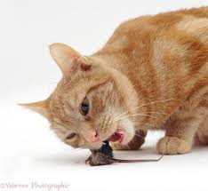
The Model and Scenarios

Slide 10
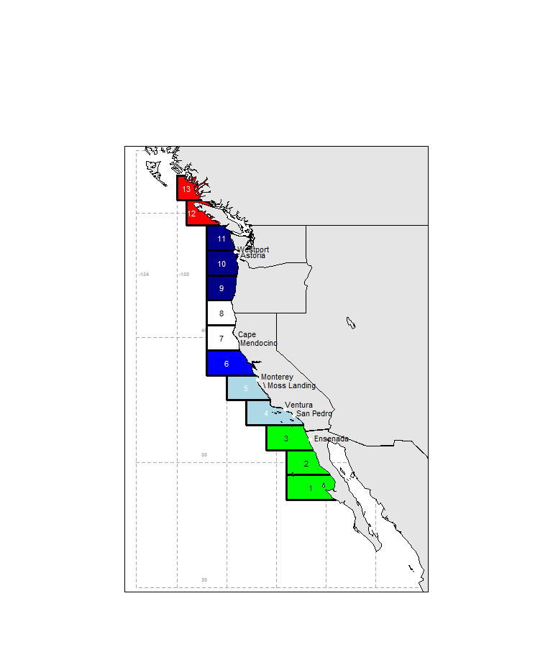
Spatial structure
13 areas from Canada to Mexico
Red: Canada
Blue: USA
Green: Mexico
Fisheries occur in all areas except areas 7 and 8.

Slide 11
Basic Structure
Environmental forcing
Predator 1
Prey species 1
FEEDING
FUNCTIONAL
RELATIONSHIP
Prey species 2
Predator 2
Prey species 3

Slide 12
The Sardine Model-I
Spatially- weekly-, and age-structured model with recruitment driven by an environmental variable (nominally sea surface temperature).
The variable G_{y} is the environmental variable.

Slide 13
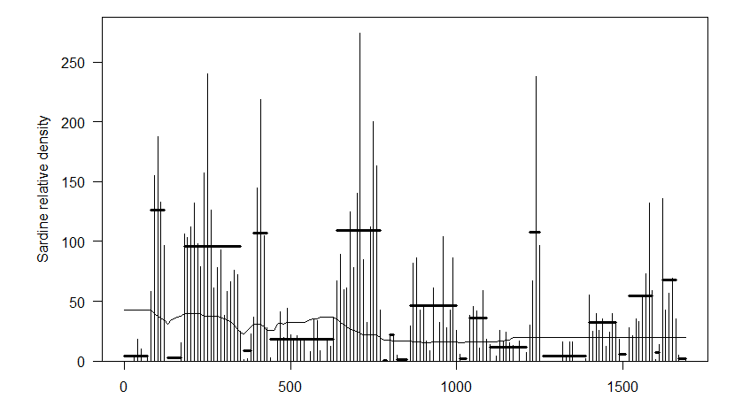
The Sardine Model-II
The period and amplitude of the variable G was chosen so that the biomass of sardine matches the variability of sardine deposition data off southern California

Slide 14
The Sardine Model-III
The sardine population moves as a (pre-specified) function of the biomass of sardine (further north when the biomass is large).
This shows the distribution of sardine of age 6 (older animals movement move that younger animals).

Slide 15
The anchovy model
Spatially- weekly-, and age-structured model with recruitment driven by the biomass of sardine and the possibility of recruitment failure:
The proportion of the anchovy biomass available to brown pelicans during the breeding season depends on the anchovy biomass.

Slide 16
Other forage and other prey
“Other forage” are modelled using a weekly age-structured model, but do not move and recruitment is uncorrelated temporally.
“Other prey” are constant

Slide 17
Harvest of Sardine
US:
  Min (ABC, HG)
  ABC = MAX(0,0.241 B¹⁺)
  HG = MAX(0.87*FRACTION*(B¹⁺ - CUTOFF),MAXCATCH)
  Fraction depends on temperature The HG cannot be less than 2,000t.
  Canada
    5% of the difference of the current biomass and 150,000t [constrained to be 22,000t or less]
    Mexico
    Constant fishing mortality (set to achieve the average catch from 1981-2009)

Slide 18
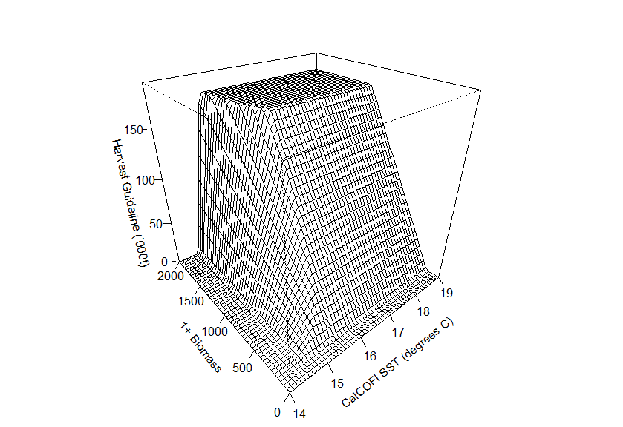
Harvest of Sardine
A maximum catch
The US control rule
The Cut-off

Slide 19

Modelling Predators-I
The predators are modelled with an annual time-step.
The key factors in the predator model are:
density-dependence;
prey impacts on survival; and
prey impacts on breeding success

Slide 20
Modelling Predators-II
Fecundity / survival of age-0 animals is density-dependent (and stochastic):
where is the number of mature predators and is the number of mature animals relative to the number in an unfished state. For the base model, breeding success is related to prey abundance according to a Beverton-Holt like function:

Slide 21
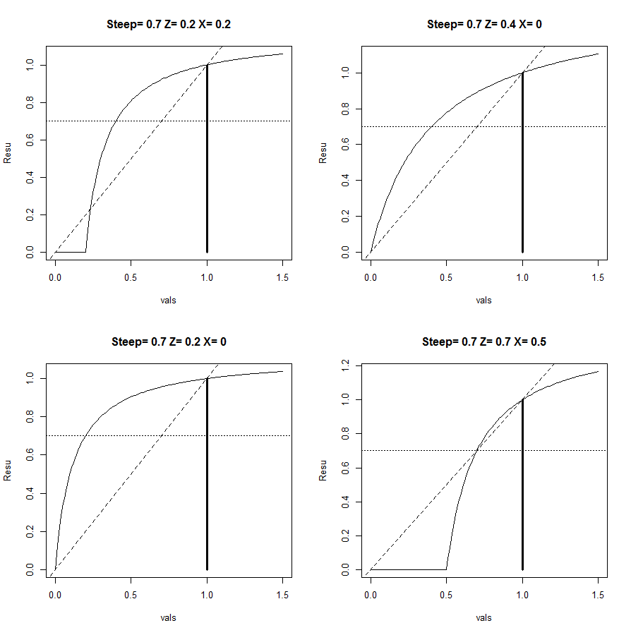
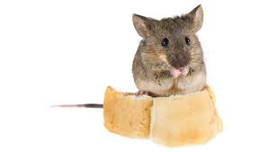
Modelling Predators-III
The prey available to predators is given by:
Prey biomass
Preference

Slide 22
Parameterization-I
The MICE model is not fitted to the available data by maximizing a likelihood function. Rather:
the stock-recruitment relationships for sardine and anchovy are based on assessment results;
the demographic parameters for prey and predators are taken from literature values; and
the relationship between prey and predators is based on data on the breeding success for brown pelican (and diet / assessment model estimates of biomass).
There is clearly considerable uncertainty.

Slide 23
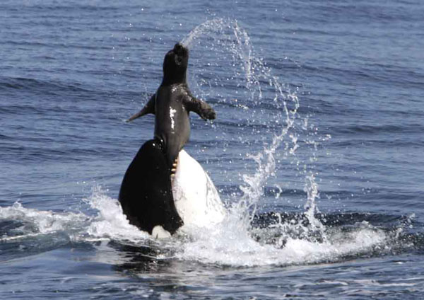
Parameterization-II

Slide 24

Sensitivity Scenarios
Sensitivity (23 scenarios) is explored to:
Prey-predator functional relationship
Whether prey impact survival or breeding success
Predator intrinsic rate of growth
Sardine stock-recruitment relationship
              Ignore regime-shift changes in recruitment
Anchovy stock-recruitment relationship
Dynamics of “other forage”
Assessment uncertainty (or lack thereof)

Slide 25
Some Results

Slide 26
Results Overview
Validation
Is the model consistent with the available data – does it behave as we would expect it to?
sardine and anchovy should vary regime-like, and brown pelican should
occasionally drop to low levels.
Projections
What are consequences for catches, prey biomass and predator numbers of the current management system?
How sensitive are the results to uncertainty regarding processes and parameter values?

Slide 27
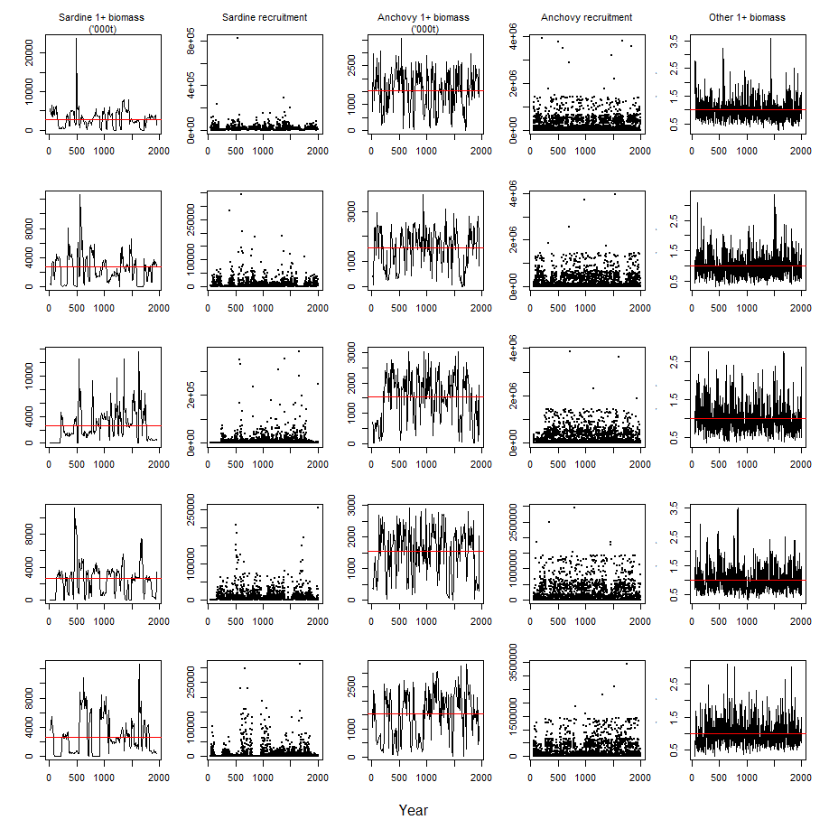
Validation-I
sardine and anchovy vary in a regime-like manner
“other forage” varies more “randomly”

Slide 28
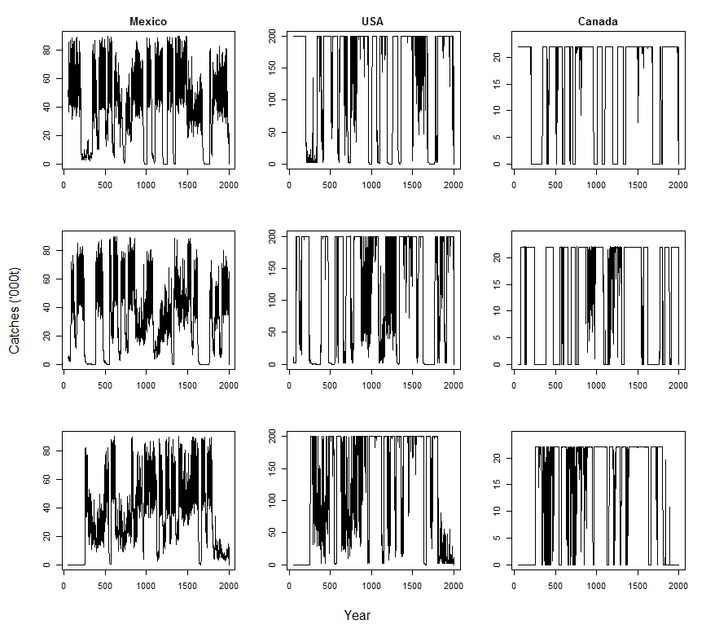
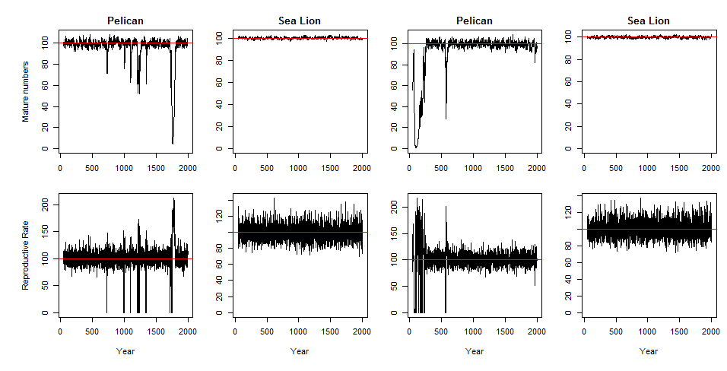
Validation-II
Brown pelicans vary considerably – including sometimes declining to very low levels
California sea lions show virtually no variation in abundance even though their breeding success varies.
Catches off the USA and Canada vary more than off Mexico – because of the cut-off in the control rule.

Slide 29
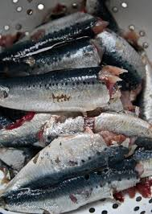
Projection results
Projections were use to compare scenarios with and without fishing
The average catch is 167,000t for the baseline scenario (but there is considerable variability), e.g. catches less than 50,000t occur in over 30% of years.
On average, prey populations stay close to the levels if there was no fishing, but fishing increases the probability of being below 150,000t (by 4.8%) and being below 400,000t (by 6.9%).
The probability of brown pelicans being less than half of their unfished level increased by 1.1% with fishing.

Slide 30

Key sensitivities
Focus for sensitivity was on whether the difference between the with- and without- fishing scenario results changed. The most important factors were:
The parameters of the relationship between prey abundance and breeding success.
Whether prey abundance impacts breeding success or survival.
The intrinsic growth rate of the predators.
Whether or not recruitment changes in a regime-like manner.
Whether or not anchovy recruitment is correlated with that of sardine.

Slide 31
Broader Implications

Slide 32
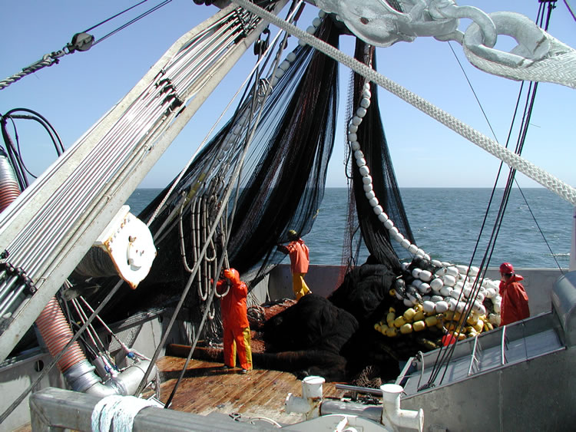
General Context (Multi-model inference)
The OMF is comparing four types of models for the CCE:
This model (a MICE)
The single-species model developed to evaluate control rules for the PFMC
An Atlantis model
A tightly-coupled climate-to-fishery model.

Slide 33
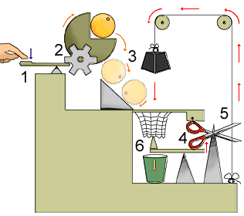
On the Design of CCE Ecosystem Models
Compare the results of projections to a “no fishing” scenario, especially when accounting for parameter and model uncertainty
Including variation on prey abundance due to regime-like effects is critical.
Conducting projections for a single set of parameters only is insufficient.
The way the management system is implemented matters!

Slide 34
Review and Evaluation
It must cover the entire range of the northern subpopulation of Pacific sardine.
The fisheries in Mexico, California, the Pacific Northwest and Canada must be explicitly represented.
The model hindcasts must replicate the behavior of major ecosystem components during 1930-present.
The dynamics of sardine should be modeled to a level consistent with evaluating a harvest control rule in a single-species context.
Management of other groups in the ecosystem should be based on the control rules actually in place.
Yes
Yes
Partially
Yes
N/A?

Slide 35

Synergistic Issues
The MICE Model is feeding into more complex (and slow) models and provides a way to design such models.
The process of developing the MICE model was highly collaborative and involved a broad range of disciplines.
A Mighty Mouse!

Slide 36



This work was conducted as part of the Ocean Modelling Forum. The members of the sardine case study included:
UW: Tim Essington, Tessa Francis, Kelli Johnson, Laura Koehn, Felipe Hurtado-Ferro
NOAA: Isaac Kaplan, Phil Levin, Alec MaCall (retired), Richard Parrish (retired)
Farrollon Institute: Bill Sydeman

